Slide 1


Capstone Project Seoul Bike Sharing Demand Prediction
SANDHYA KUMARI SAH

Slide 2
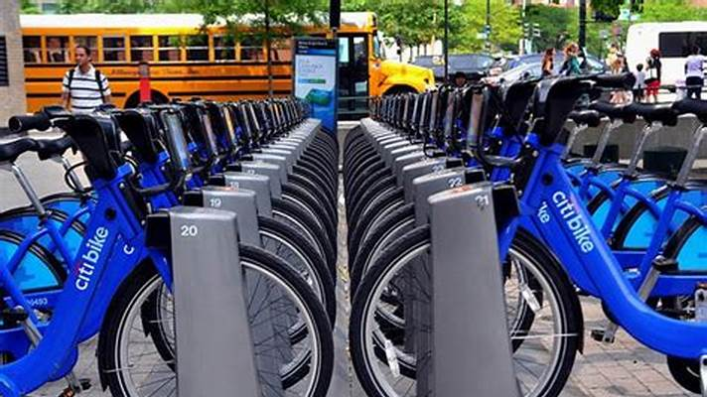
Introduction
Currently Rental bikes are introduced in many urban cities for the enhancement of mobility comfort. It is important to make the rental bike available and accessible to the public at the right time as it lessens the waiting time. Eventually, providing the city with a stable supply of rental bikes becomes a major concern. The crucial part is the prediction of bike count required at each hour for the stable supply of rental bikes.

Slide 3
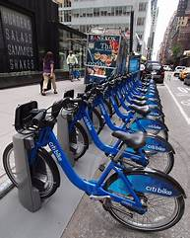

Problem Statement
We are tasked with predicting the number of bikes rented each hour so as to make an approximate estimation of the number of bikes to be made available to the public given a particular hour of the day

Slide 4

Content
❑ Data Pipeline
❑ Data Description
❑ Exploratory Data Analysis
❑ Models performed
❑ Model Validation & Selection
❑ Evaluation Matrix of All the models
❑ Model Explain ability – SHAP
❑ Challenges
❑ Conclusion

Slide 5

Data Pipeline
● Exploratory Data Analysis (EDA): In this part we have done some EDA on the features to see the trend.
● Data Processing: In this part we went through each attributes and encoded the categorical features.
● Model Creation: Finally in this part we created the various models. These various models are being analysed and we tried to study various models so as to get the best performing model for our project

Slide 6

Data Description
The dataset contains weather information (Temperature, Humidity, Windspeed, Visibility, Dewpoint, Solar radiation, Snowfall, Rainfall), the number of bikes rented per hour and date information
Attribute Information:
Date : year-month-day
Rented Bike count - Count of bikes rented at each hour
Hour - Hour of the day
Temperature-Temperature in Celsius
Humidity - %
Windspeed - m/s
Visibility - 10m​
Dew point temperature - Celsius​
Solar radiation - MJ/m2​
Rainfall - mm​
Snowfall - cm​
Seasons - Winter, Spring, Summer, Autumn​
Holiday - Holiday/No holiday​
Functional Day – No Func(Non Functional Hours), Fun(Functional hours)​

Slide 7


Exploratory Data Analysis Of The Data Set
An EDA is a thorough examination meant to uncover the underlying structure of a data set and is important for a company because it exposes trends, patterns, and relationships that are not readily apparent.

Slide 8
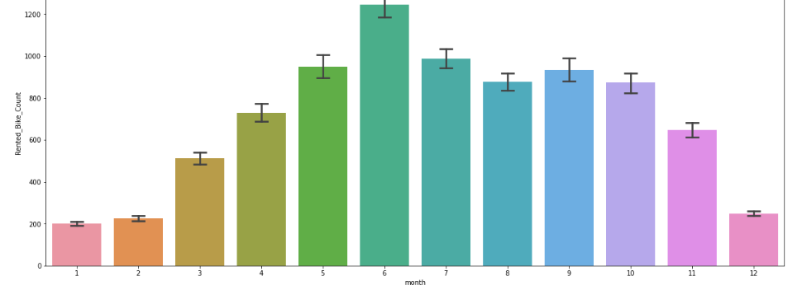
EDA-Months
We can see that there less demand of Rented bike in the month of December, January, February i.e. during winter seasons
• Also demand of bike is maximum during May, June, July i.e. Summer seasons

Slide 9
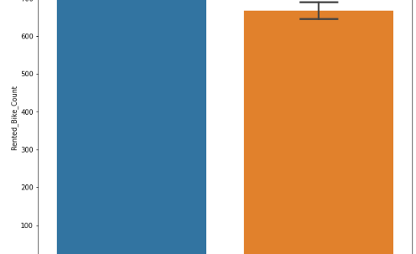
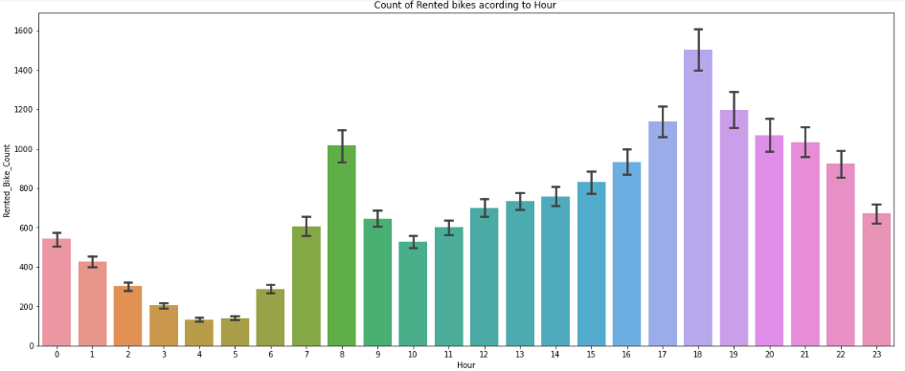
EDA-WEEKDAYS_WEEKEND
rom the above point plot and bar plot we can say that in the week days which represent in blue color show that the demand of the bike higher because of the office.
Peak Time are 7 am to 9 am and 5 pm to 7 pm*
The orange color represent the weekend days, and it show that the demand of rented bikes are very low specially in the morning hour but when the evening start from 4 pm to 8 pm the demand slightly increases.*

Slide 10
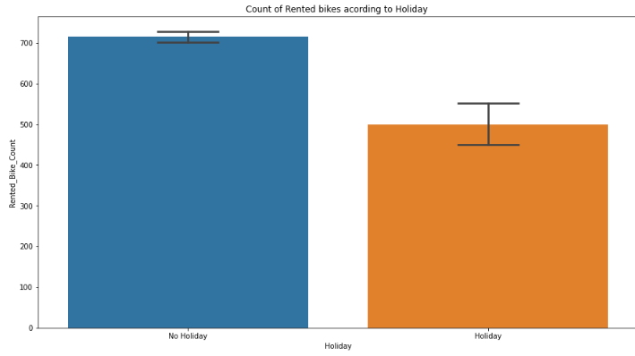
EDA-Functioning Day
In the above bar plot and point plot which shows the use of rented bike in functioning days or not, and it clearly shows that,
Peoples don't use rented bikes in no functioning day.

Slide 11
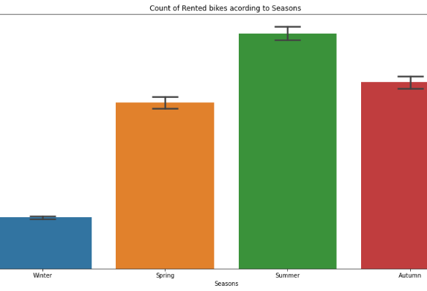
EDA-Seasons
In the above bar plot and point plot which shows the use of rented bike in in four different seasons, and it clearly shows that,
In winter season the use of rented bike is very low because of snowfall.

Slide 12
EDA-Holidays
In the above bar plot and point plot which shows the use of rented bike in a holiday, and it clearly shows that,Peoples don't use rented bikes in no functioning day.

Slide 13
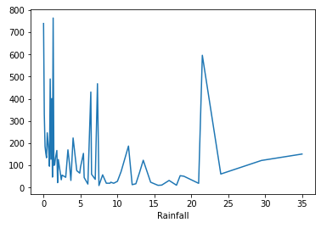
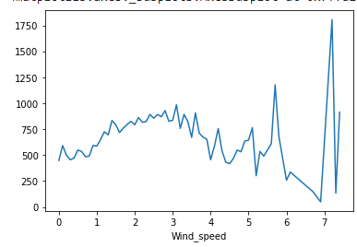
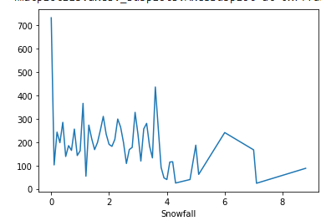
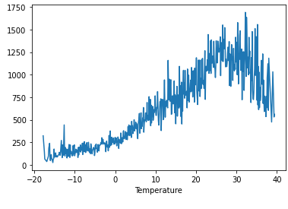
EDA- Temperature
From the above plot we see that people like to ride bikes when it is pretty hot around 25°C in average.
We can see from the plot that, on the y-axis, the amount of rented bike is very lower, When we have more than 4 cm of snow, the bike rents is much lower.
We can see from the above plot that even if it rains a lot the demand of rent bikes is not decreasing, here for example even if we have 20 mm of rain there is a big peak of rented bikes.
We can see from the above plot that the demand of rented bike is uniformly distribute despite of wind speed but when the speed of wind was 7 m/s then the demand of bike also increase that clearly means peoples love to ride bikes when its little windy.

Slide 14
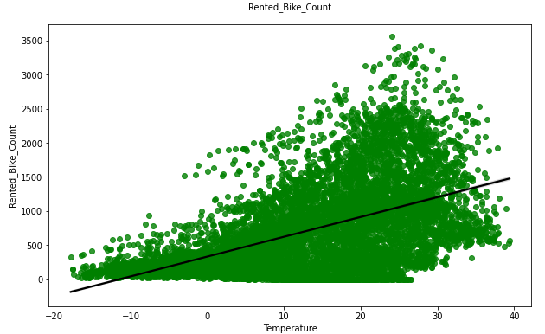
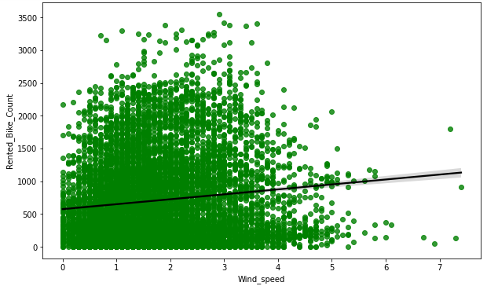
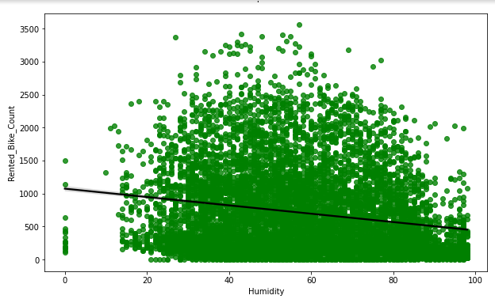
Regression Plot
We see a strong positive correlation between count and temperature .
We can see a strong negative correlation between count and humidity.
Count has a weak dependent on windspeed and several missing (or erroneous) data points (labeled as OS)-
-

Slide 15
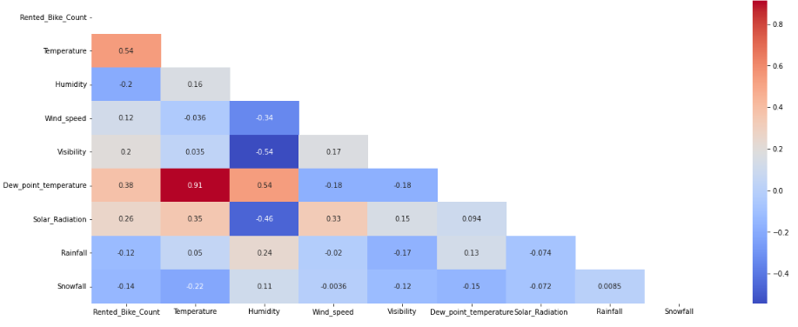
EDA - Feature Correlation
the above correlation heatmap, We see that there is a positive correlation between columns 'Temperature' and 'Dew point temperature' i.e. 0.91 so even if we drop this column then it don't affects the outcome of our analysis. And they have the same variations.. so we can drop the column 'Dew point temperature(°C)'.

Slide 16

Model Training
LINEAR REGRESSION
LASSO REGRESSION
RIDGE REGRESSION
ELASTIC NET REGRESSION
DECISION TREE
RANDOM FOREST
GRADIENT BOOSTING
GRADIENT BOOSTING REGRESSION

Slide 17
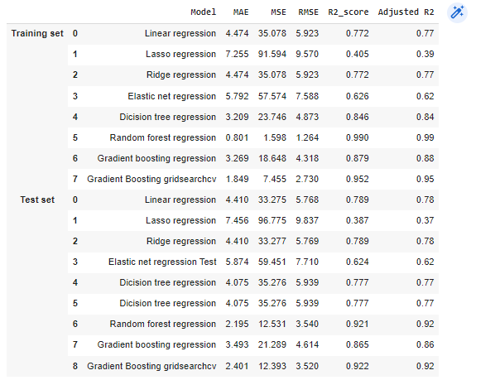
evaluation metric values for all models

Slide 18
• No overfitting is seen.
• Random forest Regressor and Gradient Boosting grid searchcv gives the highest R2 score of 99% and 95% respectively for Train Set and 92% for Test set.
• Feature Importance value for Random Forest and Gradient Boost are different.
• We can deploy this model.

Slide 19
Challenges
A huge amount of data needed to be dealt while doing the project which is quite an important task and also even small inferences need to be kept in mind.
As dataset was quite big enough which led more computation time

Slide 20
CONCLUSION
During the time of our analysis, we initially did EDA on all the features of our dataset. We first analysed our dependent variable, 'Rented Bike Count' and also transformed it. Then we analysed categorical variable and dropped the variable who had majority of one class, we also analysed numerical variable, found out the correlation, distribution and their relationship with the dependent variable. We also removed some numerical features which had mostly 0 values and hot encoded the categorical variables.
Next we implemented 7 machine learning algorithms Linear Regression, lasso, ridge, elastic Net, decision tree, Random Forest and XG Boost. We did hyperparameter tuning to improve our model performance. The results of our evaluation are:
• No overfitting is seen.
• Random forest Regressor and Gradient Boosting gridsearchcv give the highest R2 score of 99% and 95%
respectively for the Train Set and 92% for the Test set.
• Feature Importance value for Random Forest and Gradient Boost is different.
• We can deploy this model
However, this is not the ultimate end. As this data is time dependent, the values for variables like temperature, windspeed, solar radiation etc., will not always be consistent. Therefore, there will be scenarios where the model might not perform well. As Machine learning is an exponentially evolving field, we will have to be prepared for all contingencies and also keep checking our model from time to time. Therefore, having a quality knowledge and keeping pace with the ever evolving ML field would surely help one to stay a step ahead in future.

Slide 21


